Slide 1
Personal Bank Ledger and Statement Generator
TEAM NO : 10
Student Name : R.Sai Kumar Roll No : 2620090005
Student Name : Narasimha Reddy Roll No : 2620040086

Slide 2
Abstract
Personal Bank Ledger and Statement Generator
Abstract :
The Personal Bank Ledger and Statement Generator is a Java-based application designed to maintain and generate a simple personal banking record. The system allows users to enter account details, opening balance, and multiple financial transactions. For each transaction, the user can specify the description, payment type, transaction type, and amount. The program automatically calculates the updated account balance, total deposits, and total withdrawals while preventing withdrawals that exceed the available balance. Finally, it generates a formatted bank statement displaying all transaction details and the closing balance.
On developing this program, it helps the user to avoid paper work, it saves lot of time for user, it minimizes wrong entries. It also provides an organized and reliable method for maintaining records and generating useful reports.

Slide 3
Understanding Problem Statement
The main problem addressed by the Personal Bank Ledger and Statement Generator is the difficulty of maintaining personal financial records manually. Recording deposits and withdrawals, calculating the remaining balance, tracking transaction details, and preparing financial statements by hand can be time-consuming and may lead to calculation errors.
The system aims to provide a centralized and organized solution for managing personal transactions. It automatically updates the balance after each successful transaction, prevents withdrawals beyond the available balance, assigns unique transaction IDs and maintains a history of transactions. It also summarizes total deposits and withdrawals and generates a formatted statement for future reference.

Slide 4
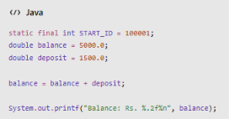
CO 1 Topics
Primitive data types: int, double, boolean
Variables and constants: variables, static final
Identifiers and literals
Operators: arithmetic, relational, logical, and assignment
Expression evaluation and operator precedence
Console input using Scanner
Formatted output using System.out.printf()
Problem-solving and program structure

Slide 5
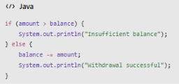
Co 2 TOPICS
Conditional statements: if, if-else
switch statement with case, break, and default
do-while loop
while loop
Enhanced for loop
Input validation using conditions
Menu-driven programming

Slide 6
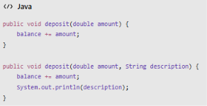
CO 3 Topics
Modular programming using methods
Parameter passing and return values
Method overloading (deposit())
Recursion: transaction searching
Searching for a transaction by ID
Traversal of transaction records
Searching for a transaction by ID

Slide 7
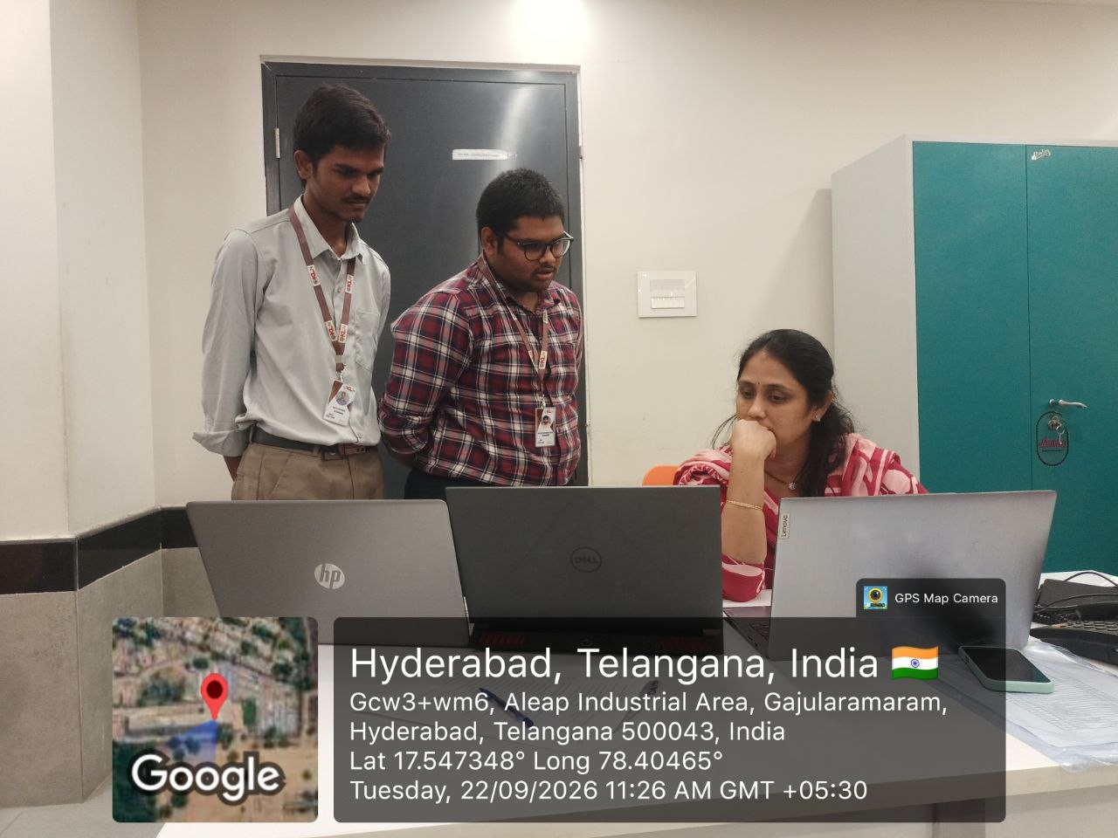
Geo Tag Photo and git hub link
GITHUB LINK : https://github.com/reddy68n/PERSONAL-BANKING-LEDGER-STATEMENT-GENERATOR.git
GITHUB NARASIMHA REDDY : https://github.com/reddy68n
GITHUB SAIKUMAR : https://github.com/ratala-saikumar

